Slide 1
Southwest Airlines Executive Report ADAM CURRY | BELLEVUE UNIVERSITY | 01/20/2021

Slide 2

Presentation Outline
The Problem
Public perception
Our bottom line
The Solution
Airlines are safe
A call to action
Market the facts
Questions

Slide 3
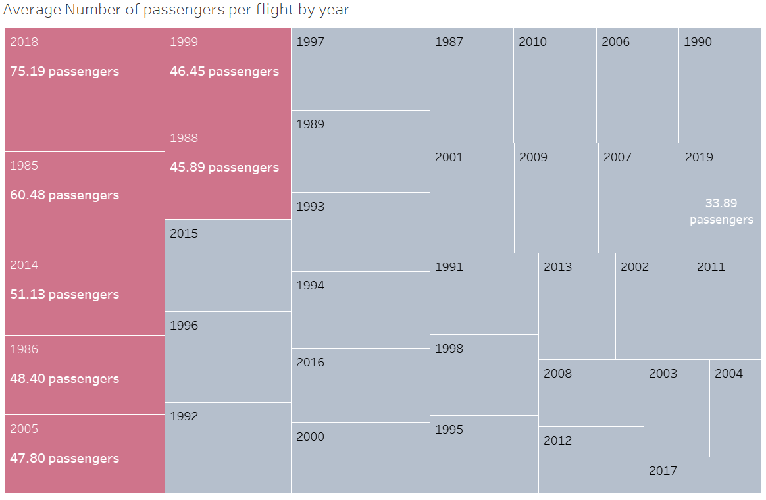
The Problem - Public Perception
2018 had 75.19 average passengers per flight
2019 had 33.89 average passengers per flight
A decline of 42.19 passengers per flight
Sources:
https://www.kaggle.com/cgurkan/airplane-crash-data-since-1908

Slide 4
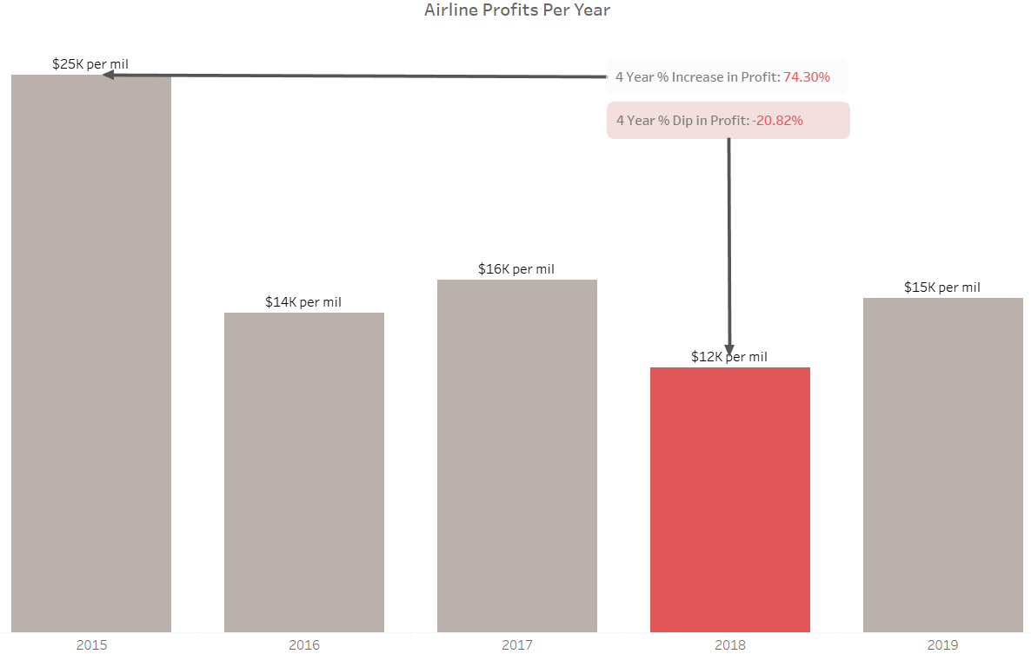
The problem – Our bottom line
In 2015 we saw a 4-year net profit increase of 74.3%
In 2018 we saw a 4-year net profit decrease of 20.82%
Sources:
https://www.airlines.org/data/

Slide 5
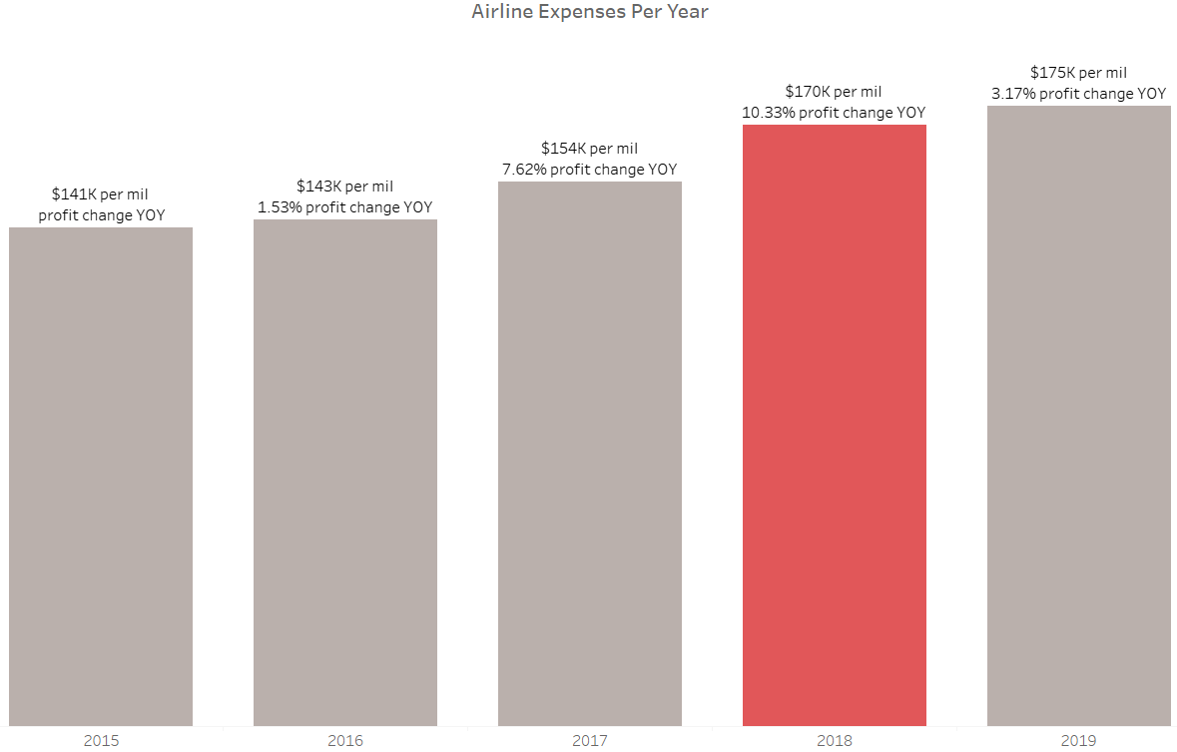
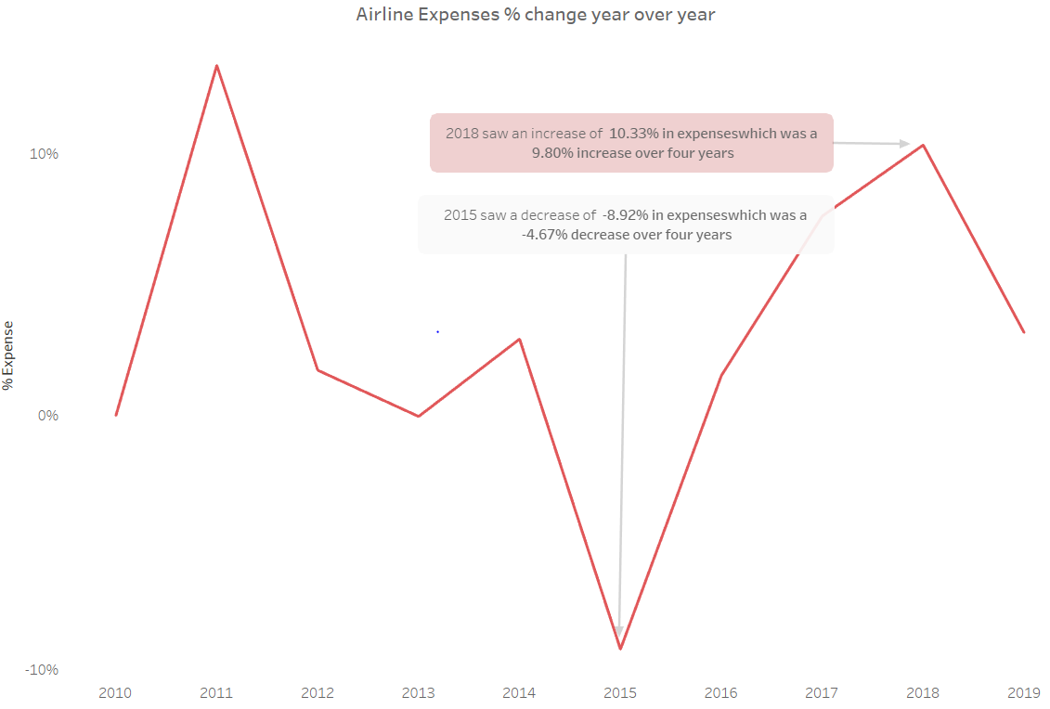
The problem – Our bottom line (cont’d)
Expenses rise YOY
In 2018 expenses saw 10.33% increase
2015 8.92% decrease in expenses
2018 10.88% increase in expenses
Sources:
https://www.airlines.org/data/

Slide 6
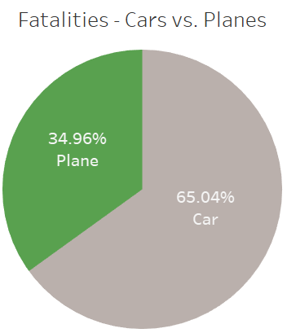
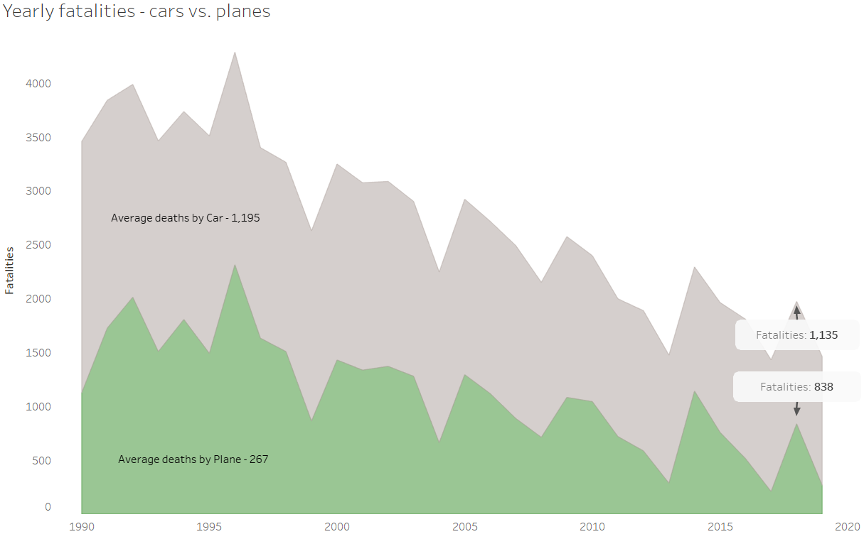
The Solution - Presenting the facts
Cars account for 65.04% of deaths when compared to planes
Cars average more deaths since 1990
Cars averaged more deaths in 2018
Sources:
https://www.kaggle.com/kevinjames1993/fatal-crashes-fatalities?select=ardd_fatal_crashes.csv

Slide 7
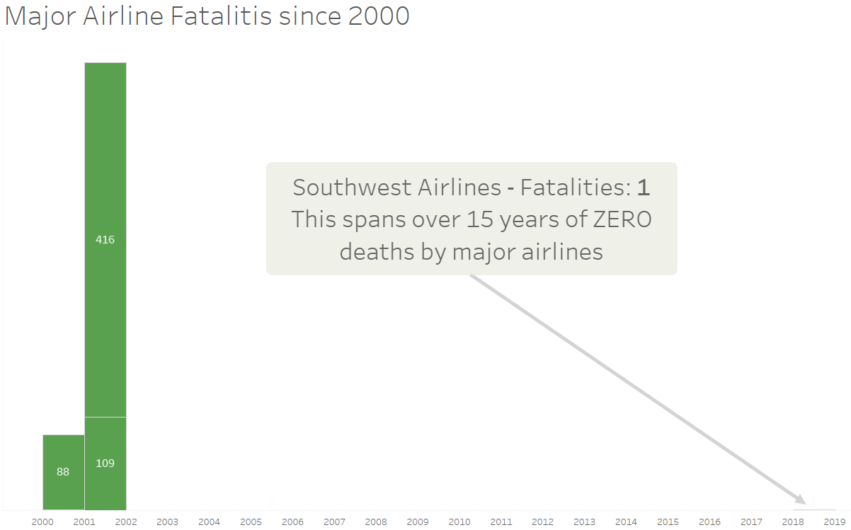
A Call To Action – Market the Facts
Major airlines remain the safest method of travel
The incident in 2018 marks the first fatality in over 15 years
Marketing has these facts at their disposal
The data presented are public domain
Sources:
https://www.kaggle.com/kevinjames1993/fatal-crashes-fatalities?select=ardd_fatal_crashes.csv

Slide 8
Questions?

